Slide 1


Online Proper Learning with Partial Feedback and Non-Random Counterexamples
Roi Livni
Joint Work with: Mark Braverman, Yishay Mansour, Shay Moran, Kobi Nissim

Slide 2

Next Bit Prediction
Motivated by training large language models.
A next bit prediction model sees a sequence $x_{1},….,x_{t}→x_{t+1}?$
Where should I eat Italian or French? French!!!

Slide 3
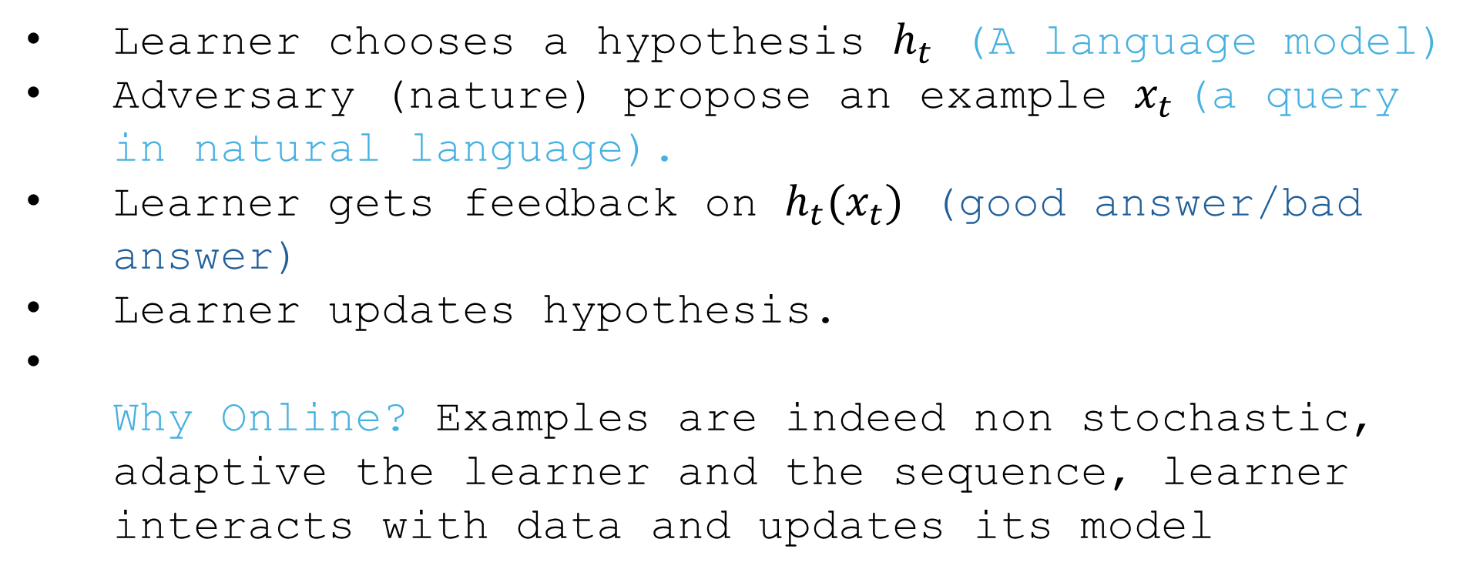
Online Learning Framework
Learner chooses a hypothesis $h_{t}$ (A language model)
Adversary (nature) propose an example $x_{t}$(a query in natural language).
Learner gets feedback on $h_{t}(x_{t})$ (good answer/bad answer)
Learner updates hypothesis.
Why Online? Examples are indeed non stochastic, adaptive the learner and the sequence, learner interacts with data and updates its model

Slide 4
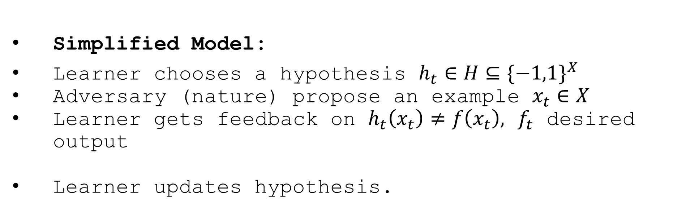
Online Learning Framework
Simplified Model:
Learner chooses a hypothesis $h_{t}∈{H⊆\{−1,1\}}^{X}$
Adversary (nature) propose an example $x_{t}∈X$
Learner gets feedback on $h_{t}\left(x_{t}\right)≠f\left(x_{t}\right),$ $f_{t}$ desired output
Learner updates hypothesis.

Slide 5
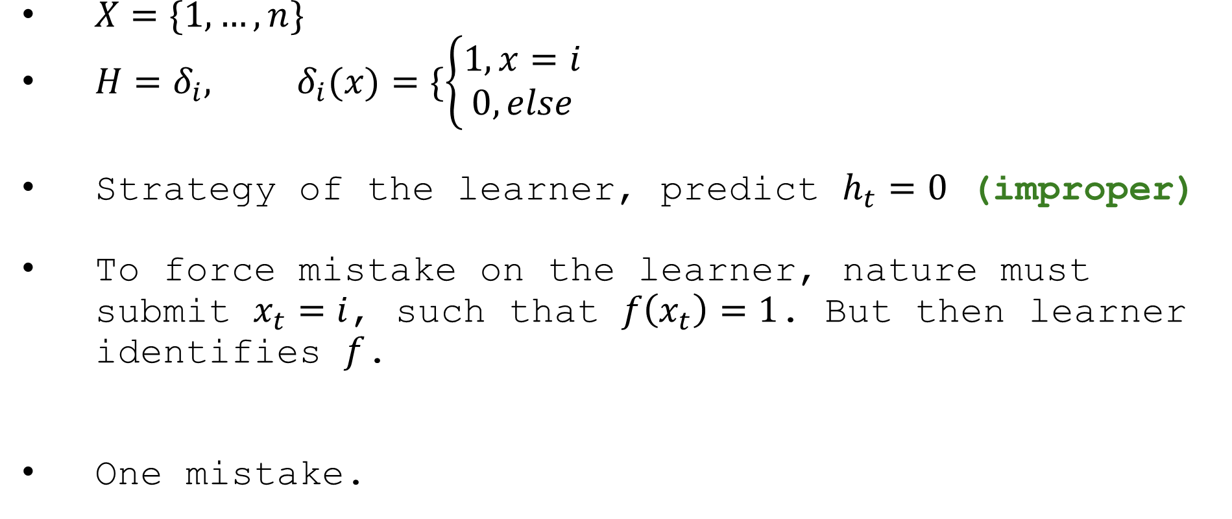
Toy Problem
$X=\{1,…,n\}$
$H=δ_{i}, δ_{i}(x)=\{\left\{\begin{aligned}1, x=i \\ 0, else\end{aligned}\right.$
Strategy of the learner, predict $h_{t}=0$ (improper)
To force mistake on the learner, nature must submit $x_{t}=i$, such that $f\left(x_{t}\right)=1$. But then learner identifies $f$.
One mistake.

Slide 6
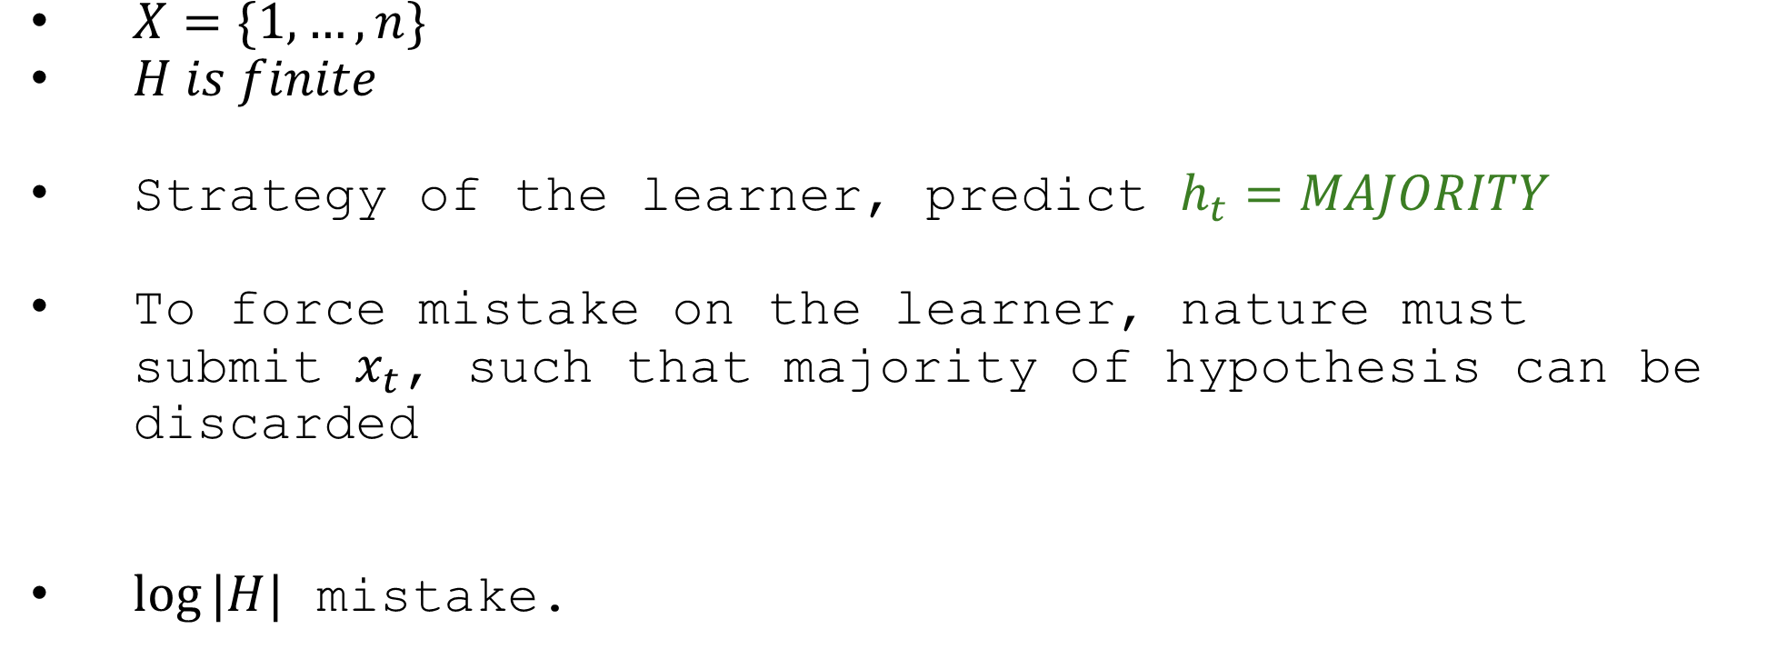
More general algortihm
$X=\{1,…,n\}$
$H is finite$
Strategy of the learner, predict $h_{t}=MAJORITY$
To force mistake on the learner, nature must submit $x_{t}$, such that majority of hypothesis can be discarded
$log⁡|H|$ mistake.

Slide 7
Next bit prediction is not enough:
H: Hey ChatGPT, where should we go for dinner — Italian, Japanese, or Mexican?
C: Let’s reason democratically. Based on general preferences I’ve learned from user data:
Most people prefer Italian over Japanese.
Most prefer Japanese over Mexican.
And most prefer Mexican over Italian.
So, Italian is preferred to Japanese, Japanese to Mexican, and Mexican to Italian.
H: Wait… that’s circular. So which one wins?
C: According to majority preference… each one.

Slide 8
Next bit prediction is not enough:
H: Hey ChatGPT, what pet should I adopt — Dog, Cat, or Parrot?
C: Let’s reason democratically. Based on general preferences I’ve learned from user data:
Most people prefer Cats over Parrots.
Most prefer Parrots over Dogs.
And most prefer Dogs over Cats.
So, Italian is preferred to Japanese, Japanese to Mexican, and Mexican to Italian.
H: Wait… who said anything about Italians?
C: According to majority preference… each one.

Slide 9
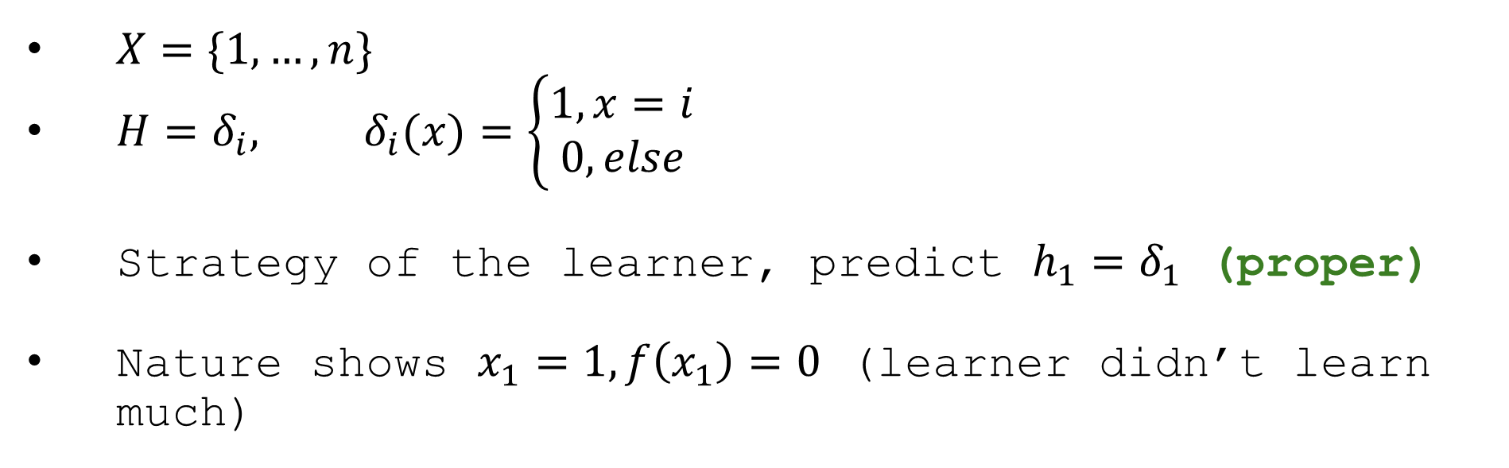
Toy Problem – enforcing properness
$X=\{1,…,n\}$
$H=δ_{i}, δ_{i}(x)=\left\{\begin{aligned}1, x=i \\ 0, else\end{aligned}\right.$
Strategy of the learner, predict $h_{1}=δ_{1}$ (proper)
Nature shows $x_{1}=1, f\left(x_{1}\right)=0$ (learner didn’t learn much)

Slide 10

Random Counter Examples
Angluin and Dohrn’ 17 suggests a random counter example model.
$h_{1}=δ_{1}$
Possible counter Examples $\{x_{1}=0, x_{i^{⋆}}=1\}$. If we pick randomly the counter example, w.p. ½ learner identifies correct hypothesis.
$$There exists a learner in the Random Counter Example model \\ With number of mistakes:O(\log{|H|).}$$

Slide 11

A minmax proof:
0-1 game on a $\left|H\right|×|H|$ matrix
Player A chooses $f_{A}∈H$, Player B chooses $f_{B}∈H$.
$M\left(f_{A},f_{B}\right)=E_{x∼{U_{f_{A}Δf_{B}}}_{}}\left[\left|\left\{h∈H, f_{A}\left(x\right)=h\left(x\right)\right\}\right|\right]$
Each player chooses a function, we randomly draw a “disagreement” point. each player wants to maximize the number of hypotheses that agree with him.
Given the adversary’s strategy: copycat him, to achieve ½|H|.

Slide 12

Algorithm:
Nature chooses $f∈H$
A t round Learner chooses $h_{t}∈H_{t}$according to maximizing strategy for the game.
In expectation, half of the hypotheses agree with $h_{t}$.
Half of the hypotheses are wrong!!!
Update $H_{t}$

Slide 13
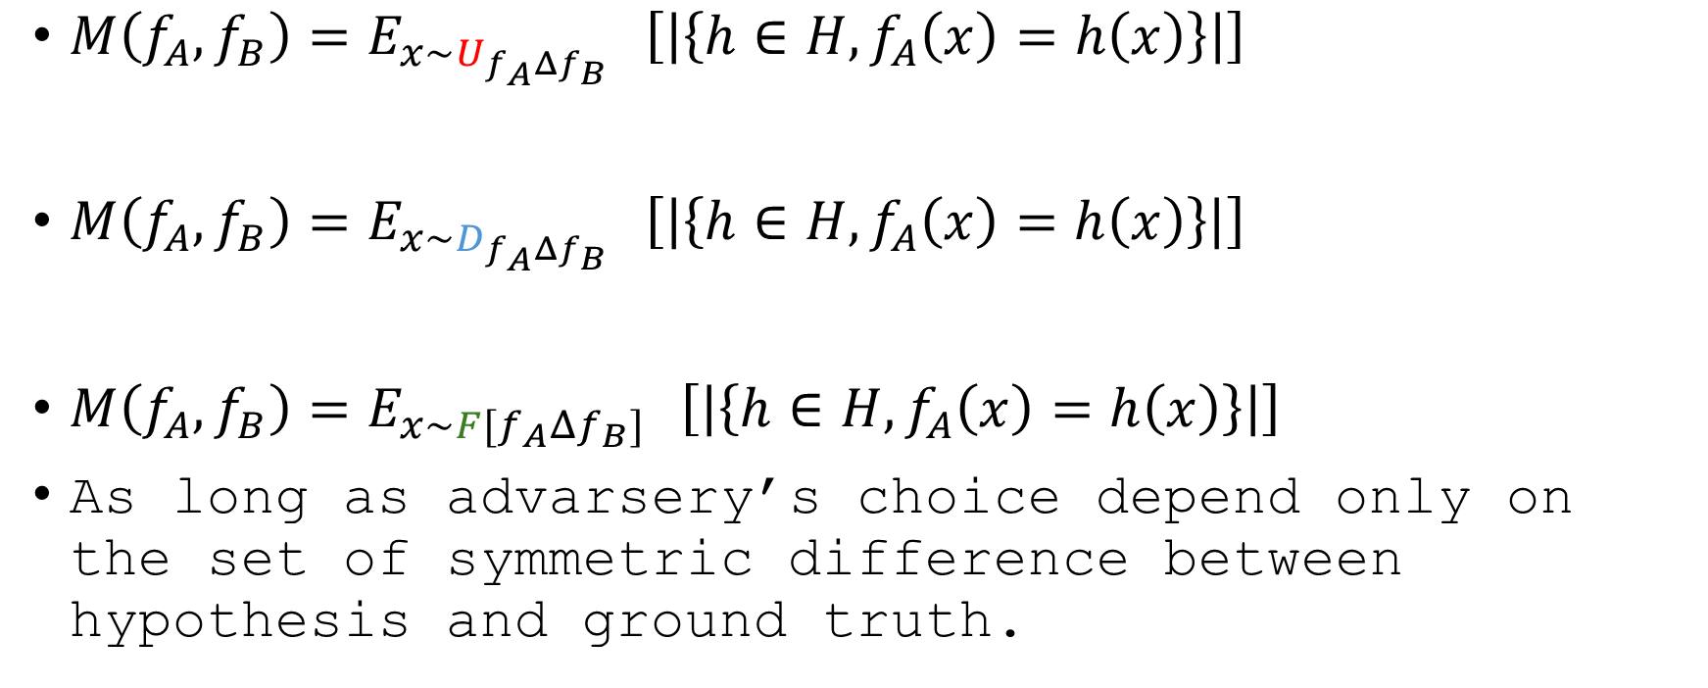
Did we use Randomness?
$M\left(f_{A},f_{B}\right)=E_{x∼{U_{f_{A}Δf_{B}}}_{}}\left[\left|\left\{h∈H, f_{A}\left(x\right)=h\left(x\right)\right\}\right|\right]$
$M\left(f_{A},f_{B}\right)=E_{x∼{D_{f_{A}Δf_{B}}}_{}}\left[\left|\left\{h∈H, f_{A}\left(x\right)=h\left(x\right)\right\}\right|\right]$
$M\left(f_{A},f_{B}\right)=E_{x∼{F[f_{A}Δf_{B}]}_{}}\left[\left|\left\{h∈H, f_{A}\left(x\right)=h\left(x\right)\right\}\right|\right]$
As long as advarsery’s choice depend only on the set of symmetric difference between hypothesis and ground truth.

Slide 14

Infinite Classes
$M\left(f_{A},f_{B}\right)=E_{x∼{F[f_{A}Δf_{B}]}_{}}\left[\left|\left\{h∈H, f_{A}\left(x\right)=h\left(x\right)\right\}\right|\right]$
$M\left(f_{A},f_{B}\right)=E_{x∼{F[f_{A}Δf_{B}]}_{}}\left[LDim\left(\left\{h:f_{A}\left(x\right)=h\left(x\right)\right\}\right)\right]$
Littlestone Dimension is online analogue of VC Dimension
$\min\left\{LDim\left(\left\{h∈H :h\left(x\right)=1\right\}\right),LDim\left(\left\{h∈H:h\left(x\right)=0\right\}\right)\right\}<LDim\left(H\right)$ Generalizes ($\min\left\{|\{h∈H:h\left(x\right)=1|,|\{h∈H:h\left(x\right)=0|\right\}<c⋅|H|$)

Slide 15
Partial Feedback

Slide 16
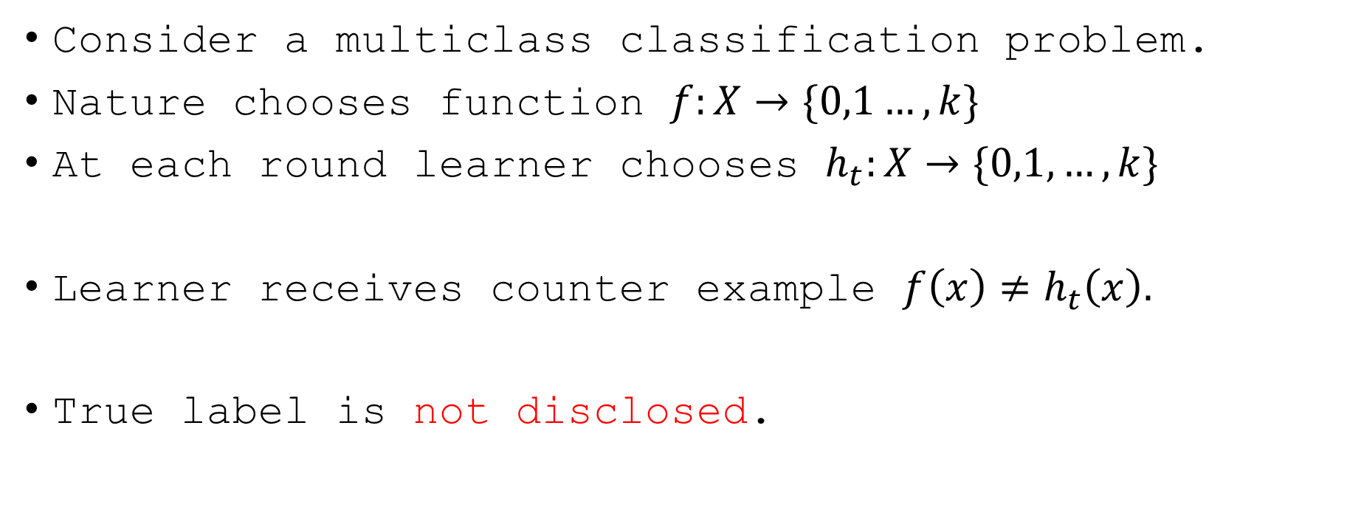
Partial Feedback
Consider a multiclass classification problem.
Nature chooses function $f:X→\{0,1…,k\}$
At each round learner chooses $h_{t}:X→\{0,1,…,k\}$
Learner receives counter example $f\left(x\right)≠h_{t}\left(x\right).$
True label is not disclosed.

Slide 17

Improper online learning
Recap: Contextual Bandits.
Learner chooses $p_{t}∈Δ_{H}$(improper)
Adversary chooses partial feedback $p(h_{t}\left(x_{t}\right))=f(x)$ (correct, incorrect)

Slide 18





Halving
H(x)
$$h\left(x\right)=3$$
$$h\left(x\right)=5$$
$$h\left(x\right)=2$$
$$h\left(x\right)=1$$
$$h\left(x\right)=4$$
$$Mistakes=O(Klog |H|)$$

Slide 19
Counter examples with Random Examples
Ground Truth: Dogs = 1 , Cats = 2 , Parrots = 3,
Majority: Dogs = 2, Cats = 3, Parrots = 1
Model: Dogs = 3 Cats = 1, Parrots = 2

Slide 20
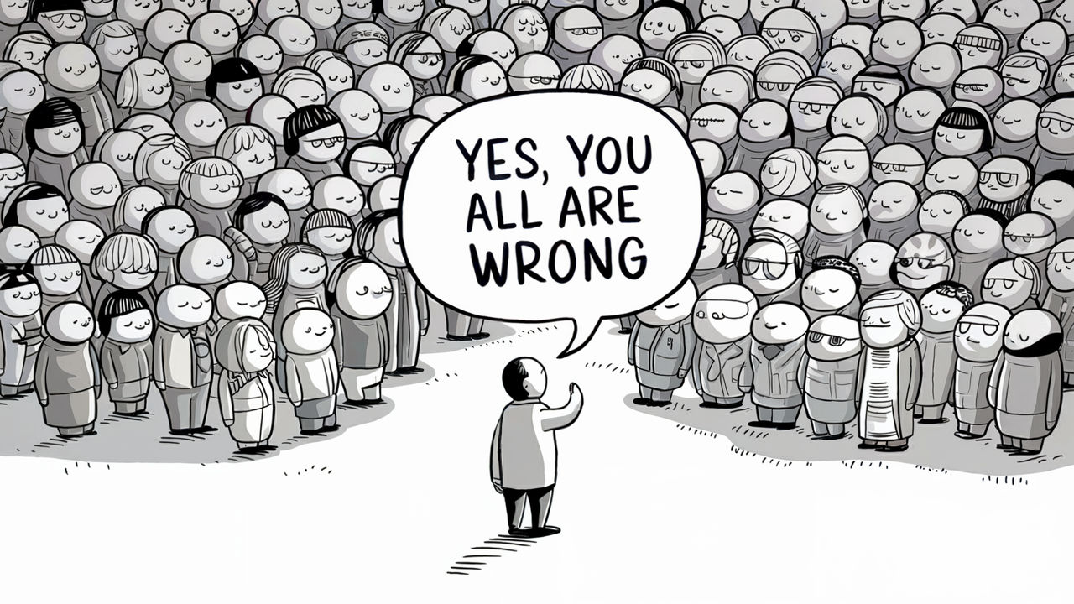

Counter examples with Random Examples
$p_{t}\left(g\right)∝\left\{\begin{aligned}0, g(x_{t})=h_{t}\left(x_{t}\right) \\ p_{t−1}\left(g\right)⋅e^{−\left|\left\{h:h\left(x\right)=g\left(x\right)\right\}\right|}, else \end{aligned}\right.$
Every hypothesis that agree with our predictor is discarded
Large “coalitions” are also punished
Intuition: We will make sure that in expectation more agree with us than with ground truth. “Large Coalition”

Slide 21

Counter examples with Random Examples
$p_{t}\left(g\right)∝\left\{\begin{aligned}0, g\left(x_{t}\right)=h_{t}\left(x_{t}\right) \\ p_{t−1}\left(g\right)⋅e^{−\left|\left\{h:h\left(x\right)=g\left(x\right)\right\}\right|}\end{aligned}\right.$
$\log{p_{t}\left(f\right)−\log{p_{t−1}\left(f\right)}≥\frac{1}{k}+\left|h:h\left(x\right)=h_{t}\left(x\right)\right|−|h:h\left(x\right)=f\left(x\right)|}$

Slide 22
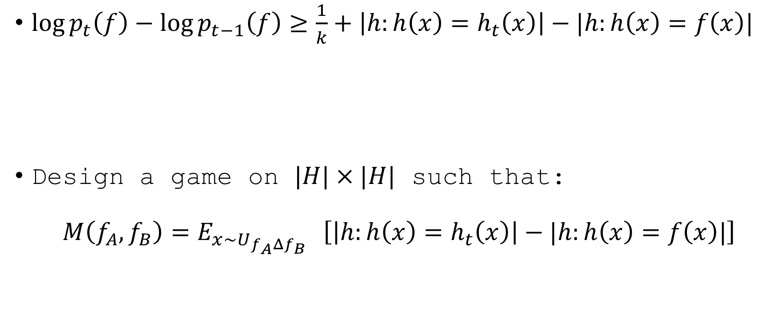
Counter examples with Random Examples
$\log{p_{t}\left(f\right)−\log{p_{t−1}\left(f\right)}≥\frac{1}{k}+\left|h:h\left(x\right)=h_{t}\left(x\right)\right|−|h:h\left(x\right)=f\left(x\right)|}$
Design a game on $|H|×|H|$ such that: $M\left(f_{A},f_{B}\right)=E_{x∼{U_{f_{A}Δf_{B}}}_{}}\left[\left|h:h\left(x\right)=h_{t}\left(x\right)\right|−|h:h\left(x\right)=f\left(x\right)|\right]$

